Slide 1

3-dars
Inheritance.
Polymorphism

Slide 2
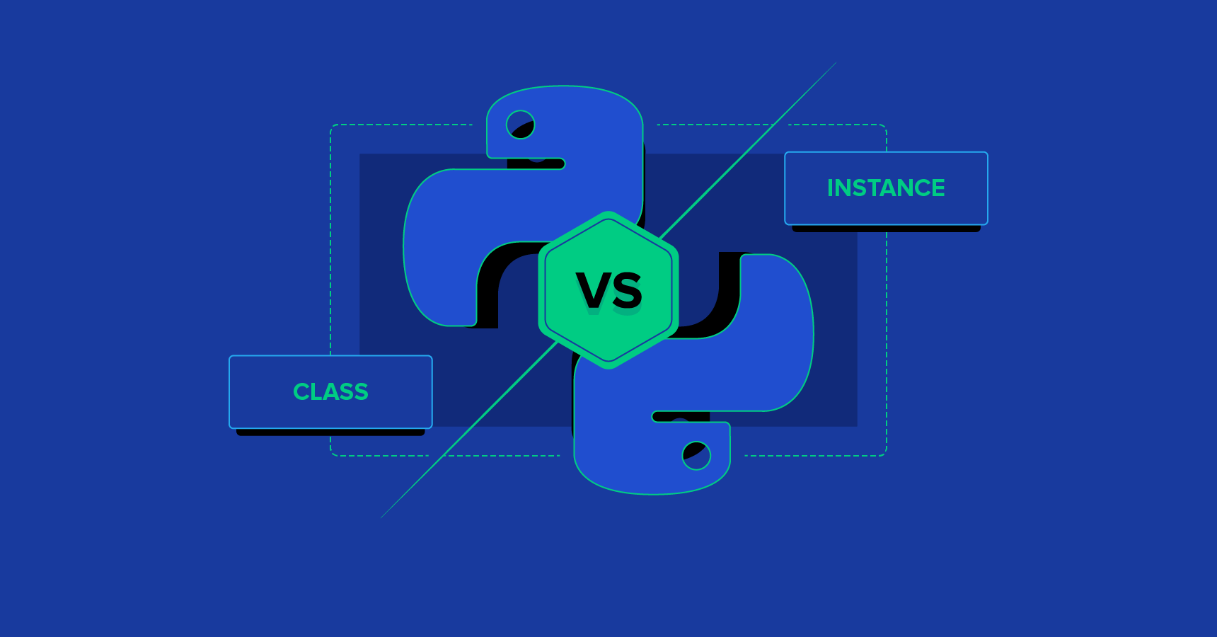
Class variable vs object variable

Slide 3
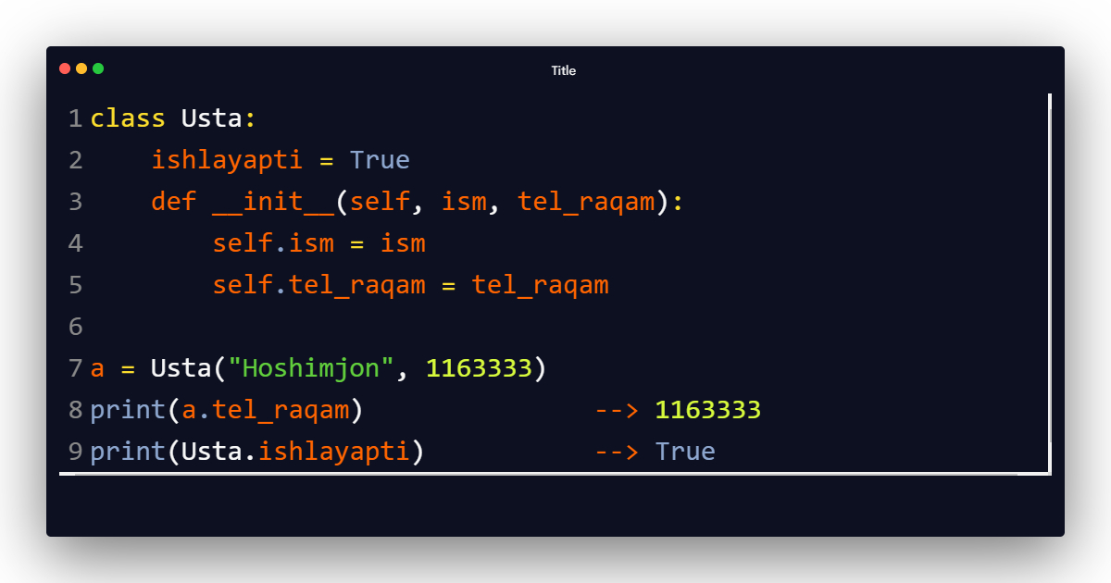
Class variable vs object variable
object variable
class variable

Slide 4
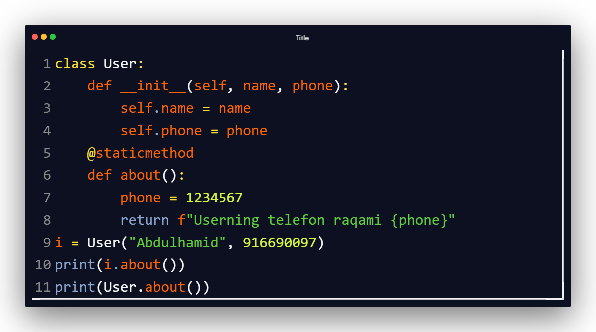
Static metodlar
Class bilan ham, obyekt bilan ham ishlatsa bo’ladi

Slide 5
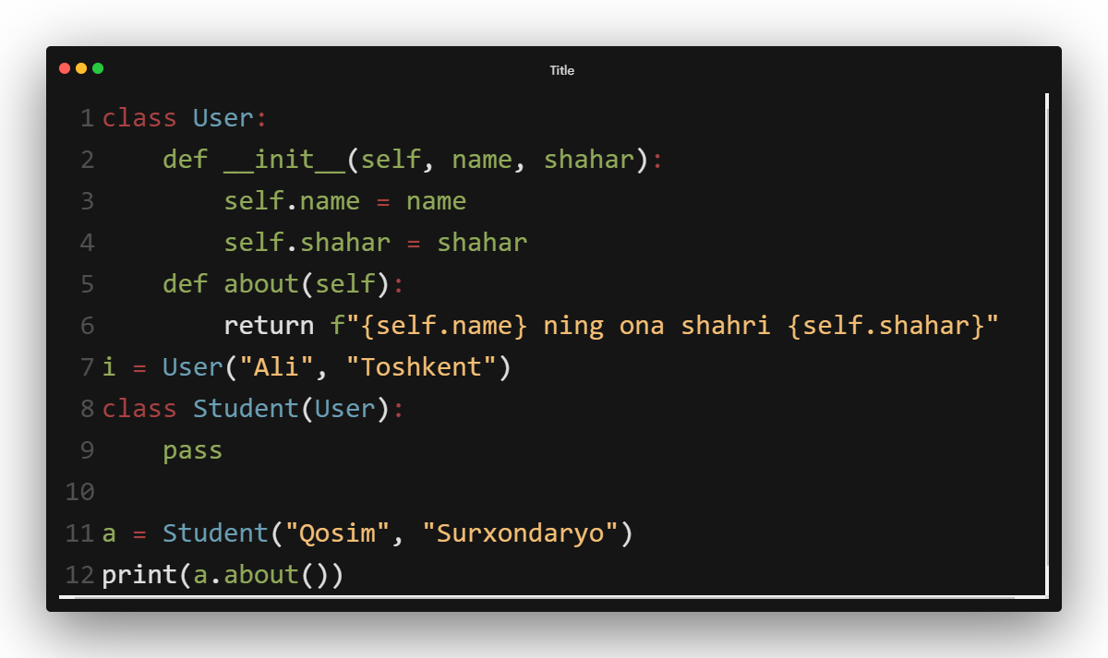
Inheritance (vorislik)
Ota class
Inheritance olindi

Slide 6
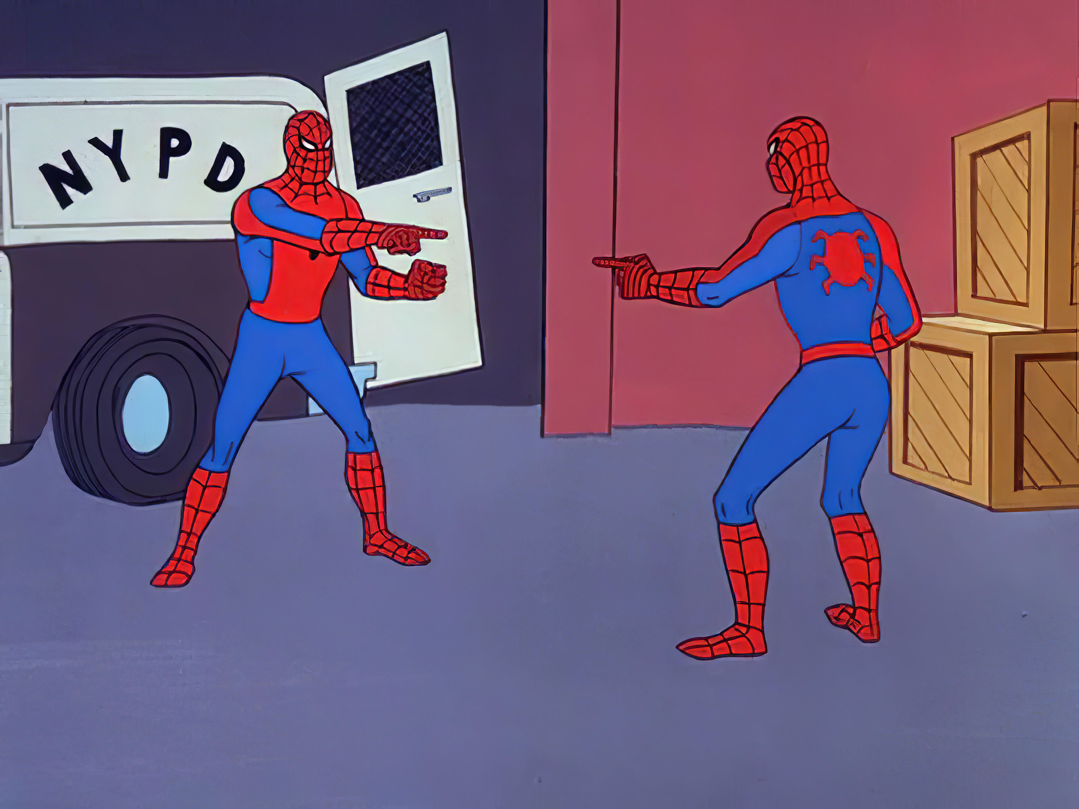
User
Student

Slide 7
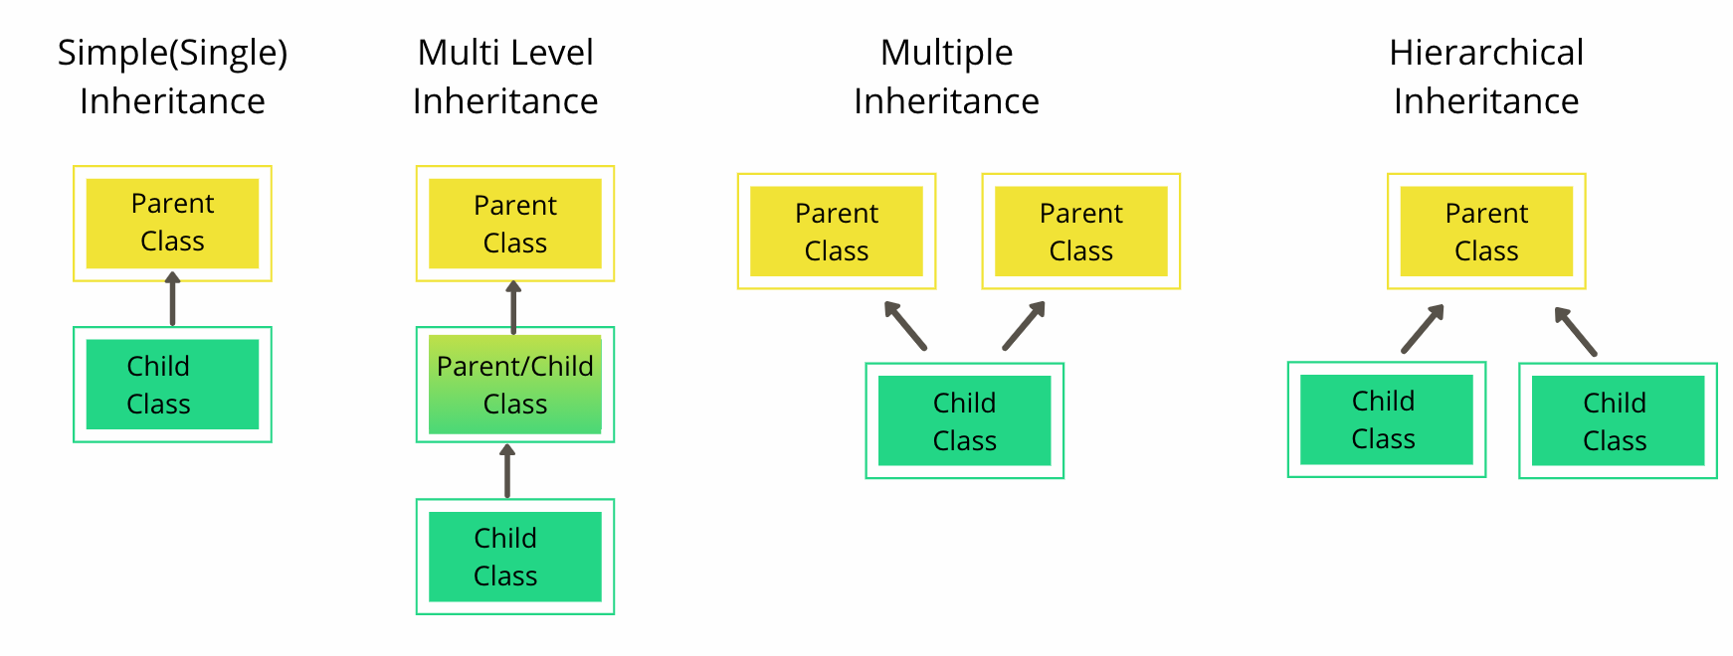

Slide 8
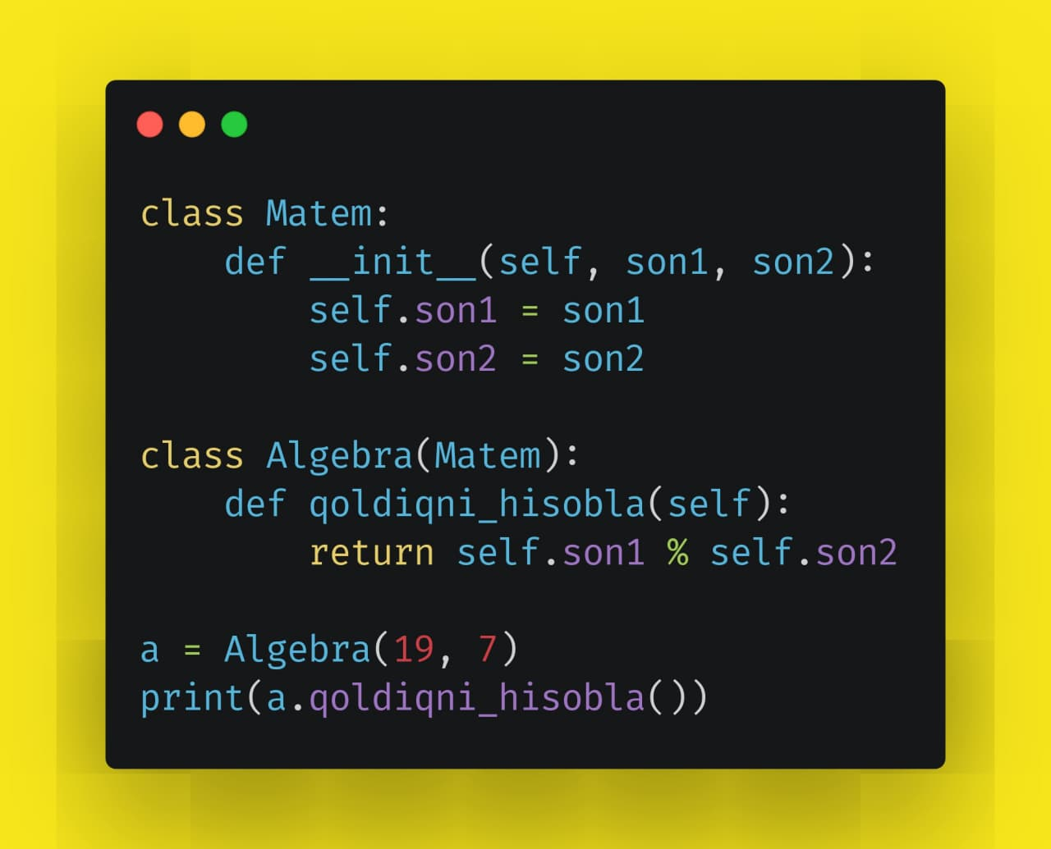

Slide 9
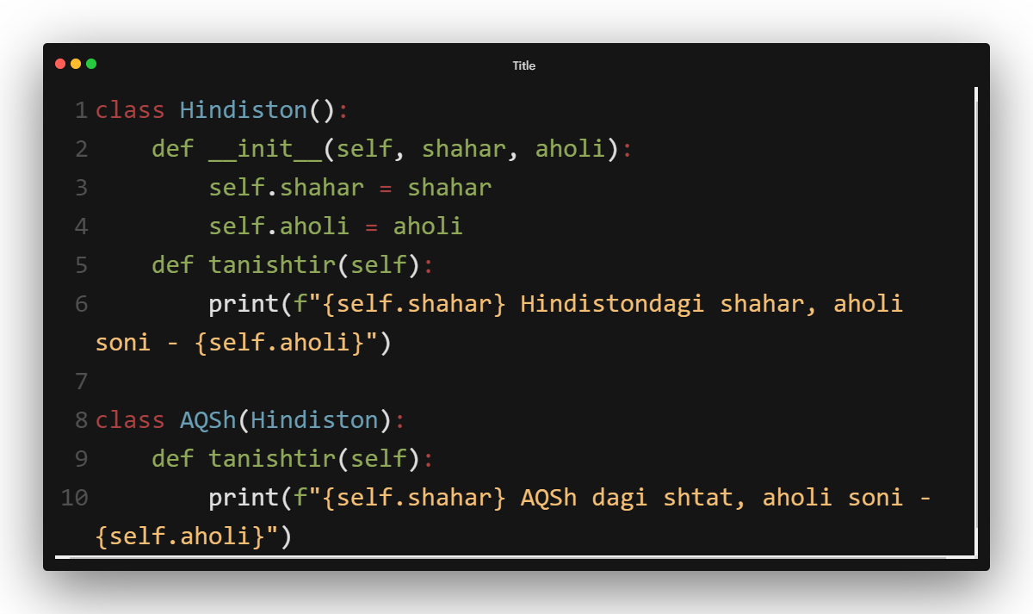
Polymorphism(overriding – ustiga yozish)
tanishtir() metodi override qilindi

Slide 10


Slide 11
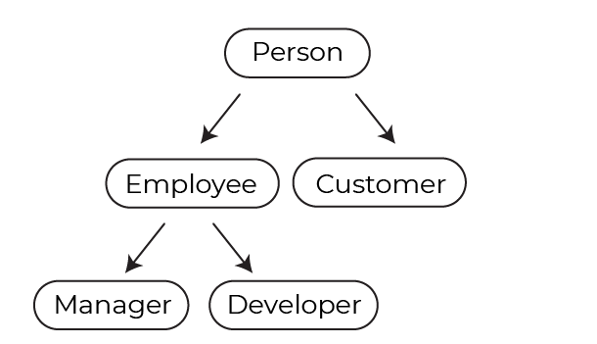
Mashq qilamiz
Yuqoridagi ketma-ketlikda inheritance oling.

Slide 12


Slide 13


